Slide 1
Molecular characterization of soybean ( Glycine max(L) using SSR markers
SUBMITTED BY
Nalwade Prasad Ram
(BTL-44/2020)
RESEARCH GUIDE
PROF. GHORPADE B.B
COLLEGE OF AGRICULTURAL BIOTECHNOLOGY, LONI
SUBMITTED TO
DEPARTMENT OF PLANT BIOTECHNOLOGY,
COLLEGE OF AGRICULTURAL BIOTECHNOLOGY,LONI.413736.
TAL-RAHATA.DIST.AHMEDNAGAR.

Slide 2
CONTENTS
Introduction
Importance of Research
Objective
Place of Research work
Materials
Methodology
Result and Discussion
Summary and Conclusion
Outcome of the Programme
Literature cited

Slide 3
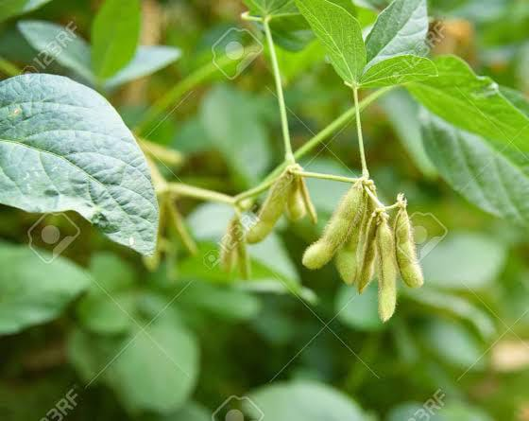
1. INTRODUCTION
Botanical Classification :-
Kingdom | Plantae
Division | Magnoliophyta
Class | Magnoliopsida
Order | Fabales
Family | Fabaceae
Genus | Glycine
Species | Glycine max
Botanical name | Glycine max.L
Glycine max

Slide 4
SOYBEAN
One of the world’s most important economic legume crops.
It is called as Golden Bean or Miracle Crop.
Cultivated soybean, one of the major crops, is used for animal feed and human foods.
It is the second most important oil seed crop in India, next to mustard
Production of soybean in India is dominated by Maharashtra and Madhya Pradesh which contribute to 89 % of total soybean production in country.

Slide 5
2. IMPORTANCE OF RESEARCH
SSR technique is useful in areas of genetic diversity and DNA fingerprinting analysis.
Genetic diversity provides opportunity for plant breeders to develop new and improved cultivars with desirable characteristics.

Slide 6
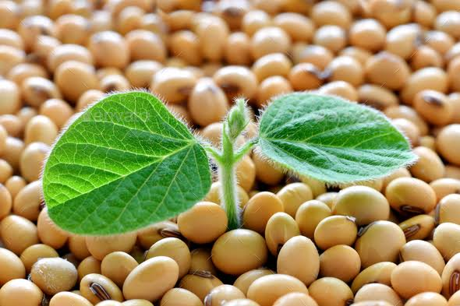
3. OBJECTIVE
To study the molecular characterization of soybean
( Glycine max(L) using SSR markers

Slide 7
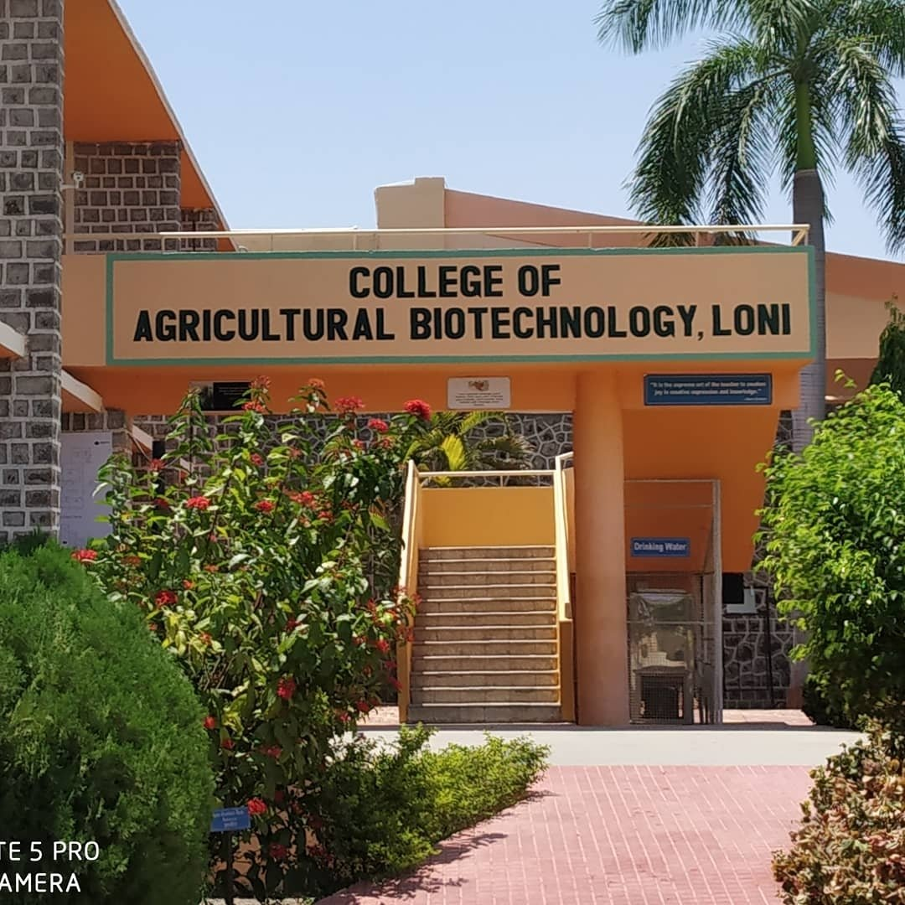
4. PLACE OF RESEARCH WORK
Department of Plant Biotechnology at College of Agricultural Biotechnology, Loni

Slide 8
5. MATERIALS AND METHOD
Plant Material
a) Soybean seeds of different genotypes.
Methodology
Germination of Soybean seeds
DNA Extraction
Agarose Gel Electrophoresis
Quantification of DNA
Dilution of DNA sample
SSR analysis for PCR Amplification

Slide 9
Plant Material
A total seven varieties of Soybean (Glycine max L.) was collected from Mahatma Phule Krishi Vidyapeeth (MPKV) research station Digras , Sangali, Maharashtra. The details are given below.
List of Selected Soybean Varieties
Sr. No | Name of Variety
1 | IVT CODE 27
2 | KDS-344
3 | AMS2014
4. | IVTCODE 20
5. | NRC147
6. | AMC-100-39
7. | RSC1107

Slide 10
Instruments
Autoclave
Refrigerator
Double distilled unit
Gel electrophoresis assembly
Microwave oven
Ice flaker machine
water bath
Chemicals
Vortex mixture
Magnetic stirrer
Gel Documentation System
Weighing balance
Micropipette
Centrifuge machine
U.V. transilluminator
Chilled isopropanol
Taq DNA polymerase
T.E Buffer (pH -8.0 )
Ethanol
Chilled isopropanol
PVP
CTAB
NaCl
Tris HCL(pH - 8.0)
EDTA (pH -8.0 )
β-mercaptoethanol
Chloroform-isoamyl alcohol

Slide 11
II. METHODOLOGY
a) Germination of Soybean seeds
The seeds of Soybean genotypes were washed with Running tap water to avoid contamination. After washing clean and round seeds of each genotype will be planted in plastic tray in Laboratory.

Slide 12
Reagents of DNA Extraction Buffer stock solution
Sr No. | Components | Quantity (100 ml)
1. | 4% CTAB | 10 ml
2. | 4M NaCl | 35 ml
3. | 1M Tris-HCl (pH-8.0) | 10 ml
4. | 1 M EDTA (pH-8.0) | 4 ml
5. | 0.3% β-mercaptoethanol | 300ml
6. | 3% PVP | 3 gm
7. | Distilled water | 41 ml

Slide 13
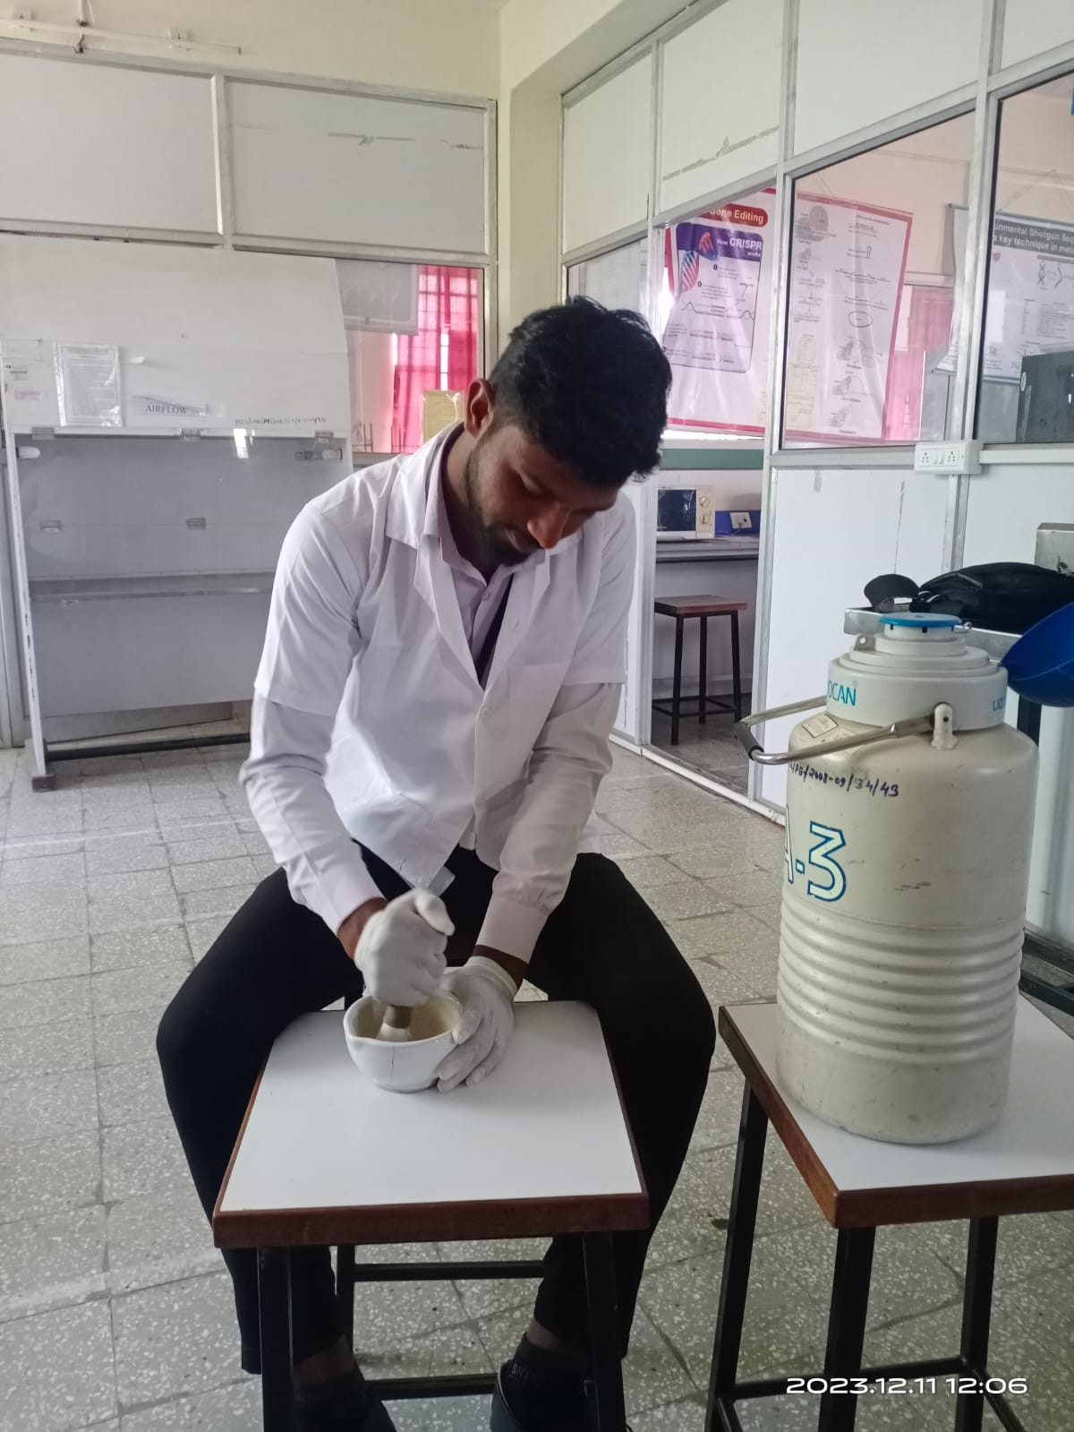
DNA Isolation Protocol
The DNA extraction buffer was prepared and kept in water bath at 65℃
for 30 min.
Leaf samples were crushed in liquid nitrogen using mortar and pestle.
Leaf powder was transfer to centrifuge tube containing 1 ml extraction
buffer and keep in water bath for 65℃ for 45 min.
Fig:- Sample Crushing

Slide 14
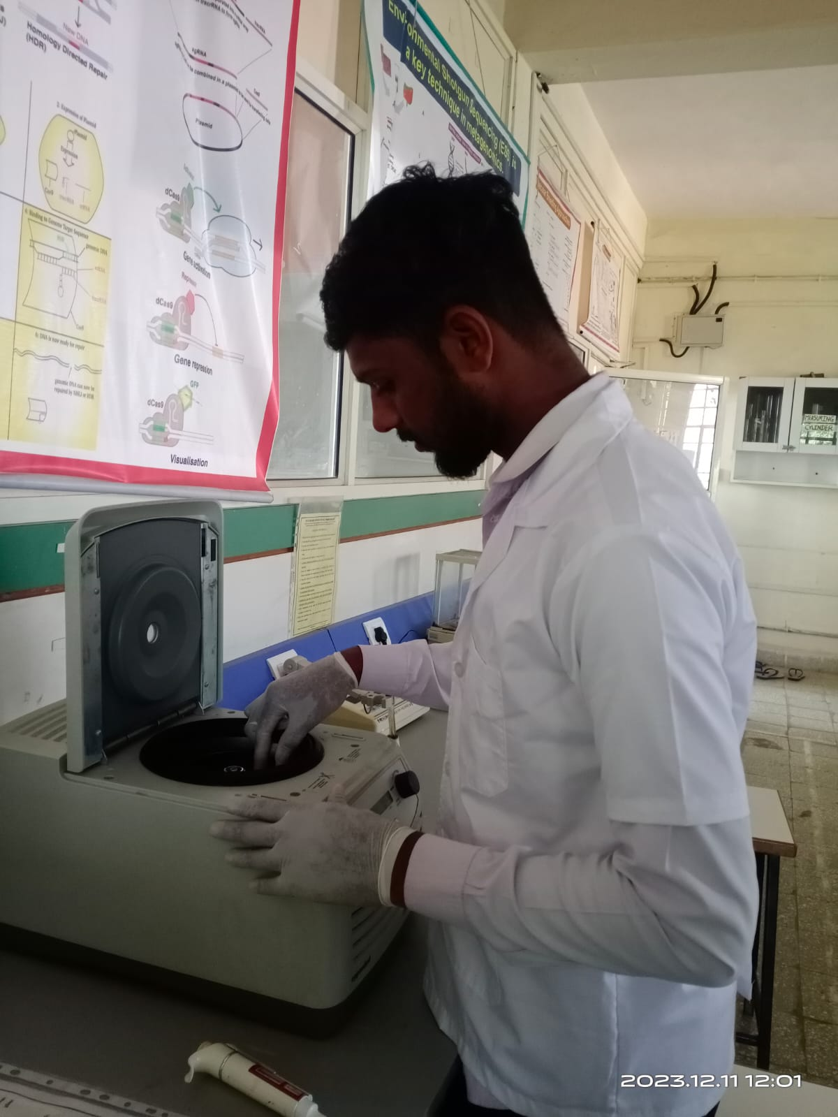
These tubes were kept in centrifuged machine at 13,000 rpm for 11 min 4℃.Then supernatant was collected in a fresh tube and equal volume of chloroform- isoamyl alcohol was added.
The tubes were followed by inversion for 5 min and then again centrifuged at 13,000rpm for 11 min at 4℃. The above steps was repeated for 2-3 times.
Then equal volume of chilled isopropanol was added in the collected supernatant and the tubes were kept for Incubation at
-20℃ for overnight .

Slide 15
On the next day, the tubes were centrifuged at 13,000 rpm for 11 min. then equal volume of ethanol was added in the collected pellet and tubes were centrifuged at 7000 rpm for 5 min.
The above step were repeated 2-3 times, then the pellet was air dry and dissolve in 250μl of 1X TE buffer and the isolated DNA was stored at -20 ℃.

Slide 16
RNase Treatment
1 μl of RNase was added into the 100 μl of isolated DNA to remove RNA contamination.
Then the tubes were incubated at 37 ℃ For 1 hour in hot water bath.

Slide 17
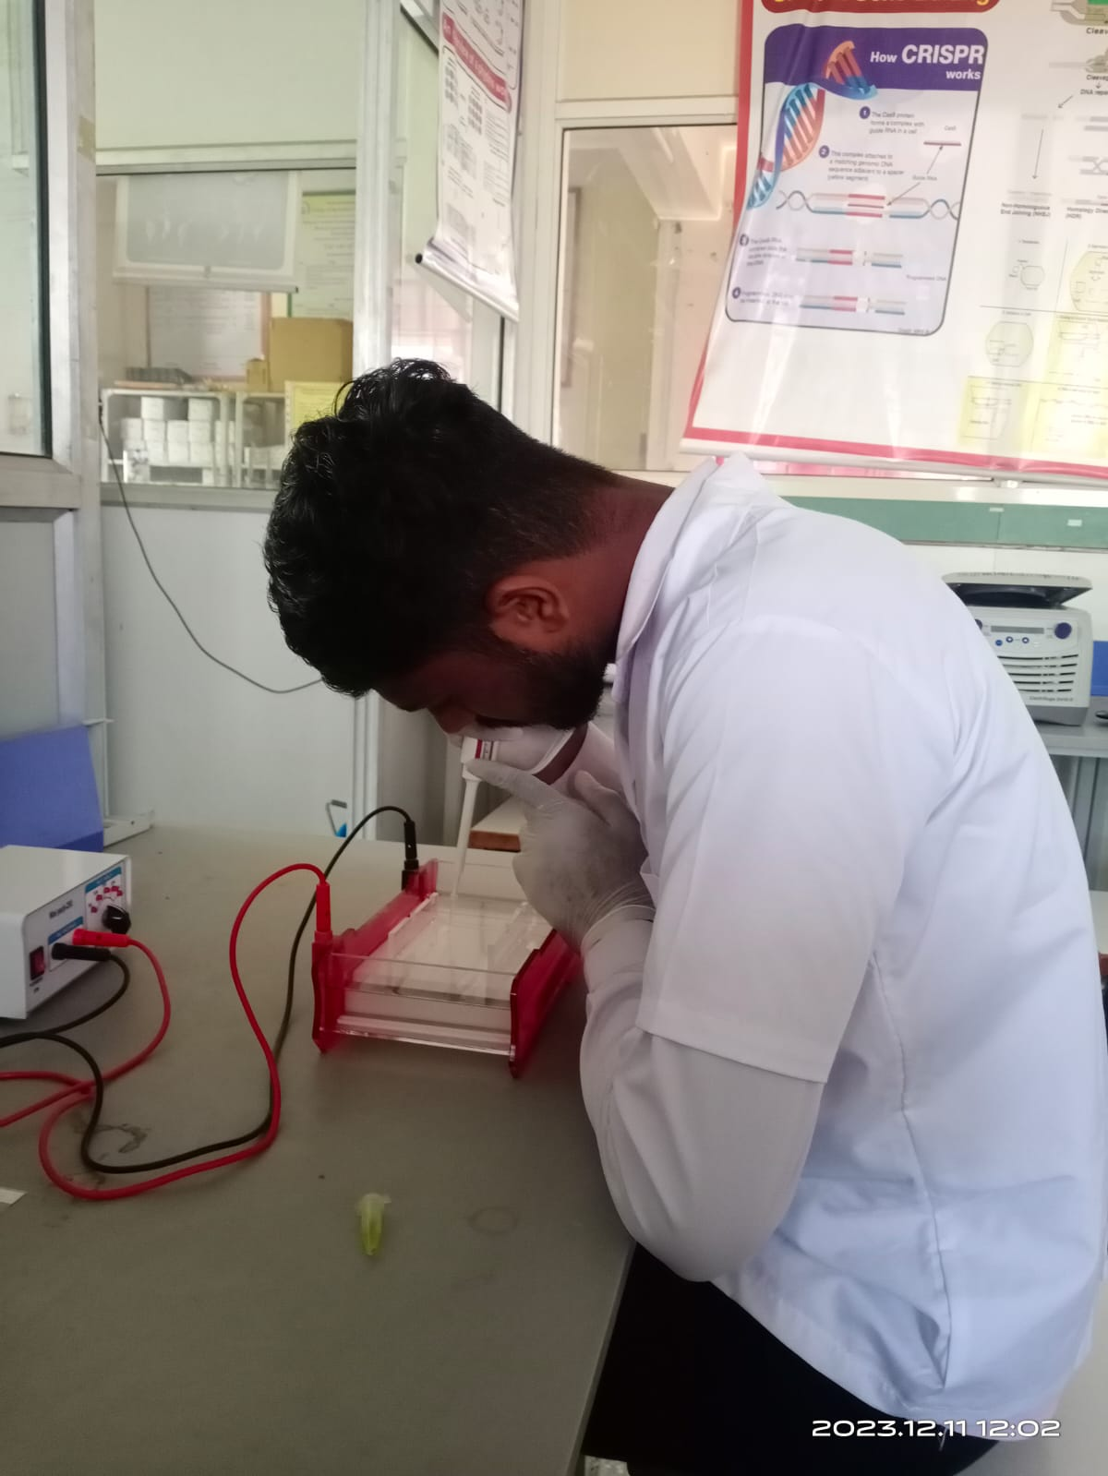
Agarose gel electrophoresis
For visualization of DNA bands, the samples were electrophoresis, by using 0.8% agarose gel.
Requirement-
1) Electrophoresis assembly 2) 0.8% agarose 3) 50X TAE buffer 4) Ethidium bromide 5) 6X gel loading dye
6) UV transilluminator

Slide 18
0.8% agarose gel was prepared and then the ethidium bromide was added as a staining agent.
Procedure of Agarose gel electrophoresis
Then, the mixture was poured into a casting tray with comb fitted into it, and allow to solidify.
The casted gel was placed in 0.5X TAE buffer tank with wells towards cathode.
5μl of DNA of different genotypes was mixed with 1μl
of 6X gel loading dye and loaded in gel.
Then the electrophoresis was carried out at 50V for an hour and after that the gel was viewed under gel documentation unit .

Slide 19
The quantity of DNA was checked using 1 μl of DNA of each Soybean varieties by using Bio-Spectrometer machine at Department of Plant Biotechnology, College of Agricultural Biotechnology Loni.
Quantification of DNA
Sr.NO | Name of genotypes | Concentration of DNA (ng/μl) | O.D (260/280)
1. | IVT CODE 27 | 1107.4 | 1.83
2. | KDS-344 | 393.8 | 1.85
3. | AMS2014 | 428.1 | 1.82
4. | IVTCODE 20 | 385.9 | 1.79
5. | NRC147 | 214.5 | 1.74
6. | AMC-100-39 | 165.2 | 1.80
7. | RSC1107 | 203.9 | 1.81

Slide 20
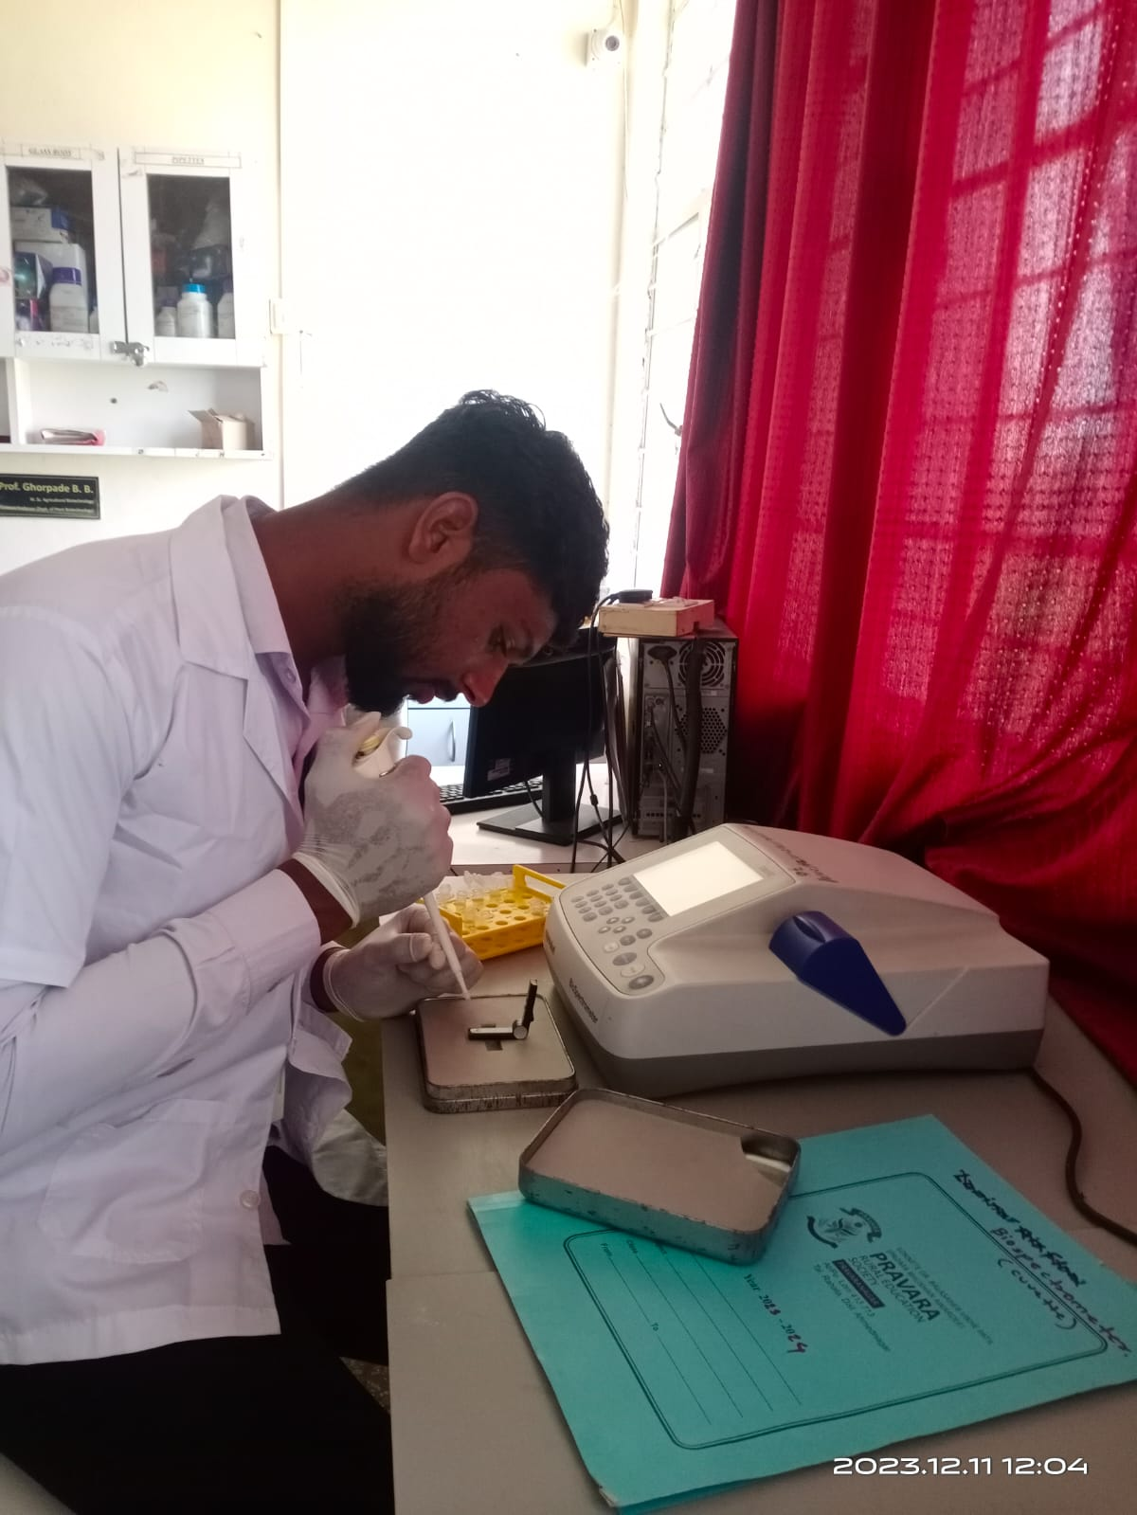
Quantification of DNA
Using 1 μl of DNA of each soybean genotype the concentration and purity of DNA was checked by using Bio-Spectrometer
Dilution of DNA sample
The dilution of the part of DNA with appropriate quantity of TE buffer was done to yield working concentration 60 ng /µl and then stored at 4^{O}C for further work until PCR amplification

Slide 21
Table 4 . List of primers were screen for amplification
Sr. No. | Primers | Sequences
1. | Satt 211 | F | GCGATCACCGGACTTAGAGAGTTA
 |  | R | GCGGAGCTAATTAAAAAGTCATTCCAATA
2. | Satt 365 | F | GCGCAAACAGTTATACCTTTATATTGGTGAA
 |  | R | GCGCAAACAGTTATACCTTTATATTGGTGAA
3. | Satt 338 | F | GCGGGGCATTAATAAACCTCCTCTAACT
 |  | R | GCGCCATTTTGGTCATTCCTAACAACT
4. | Satt 266 | F | GCGAAACTCTACGGGTCAGTAGTTAT
 |  | R | GCGTAAGATGGCCTAGAAAGAGGATG

Slide 22
Polymerase Chain Reaction PCR Reaction Mixture
Component | Final concentration | Volume (μl)
PCR Master mix | 2X Master Mix (Himedia) | 7.5
DNA sample | 60 ng/μl | 1.0
Forwad Primer | 16 Pmol | 1.0
Reverse Primer | 16 Pmol | 1.0
Mol. Grade water | - | 4.5
Total volume | - | 15

Slide 23
PCR Program
Sr. No. | Steps | Temperature (⁰ C) | Duration (min) | Number of cycles
1. | Initial Denaturation | 94 | 5
2. | Denaturation | 94 | 1 | 35
3. | Annealing | (56-65) | 1
4. | Extension | 72 | 1
5. | Final extension | 72 | 10
6. | Hold | 4 | Infinity

Slide 24
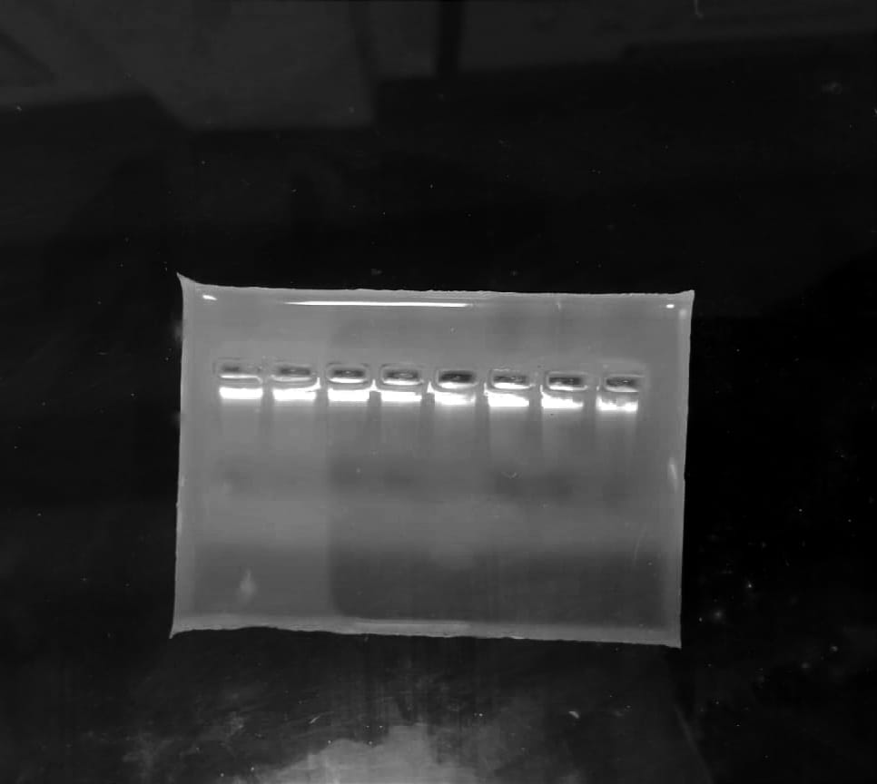
6. RESULT AND DISCUSSION
1 2 3 4 5 6 7 8
Plate 6.Genomic DNA on 0.8% agarose gel
IVT CODE 272 2) KDS-344 3) AMS2014 4) IVTCODE 20
5) NRC147 6) AMC-100-39 7) RSC1107

Slide 25
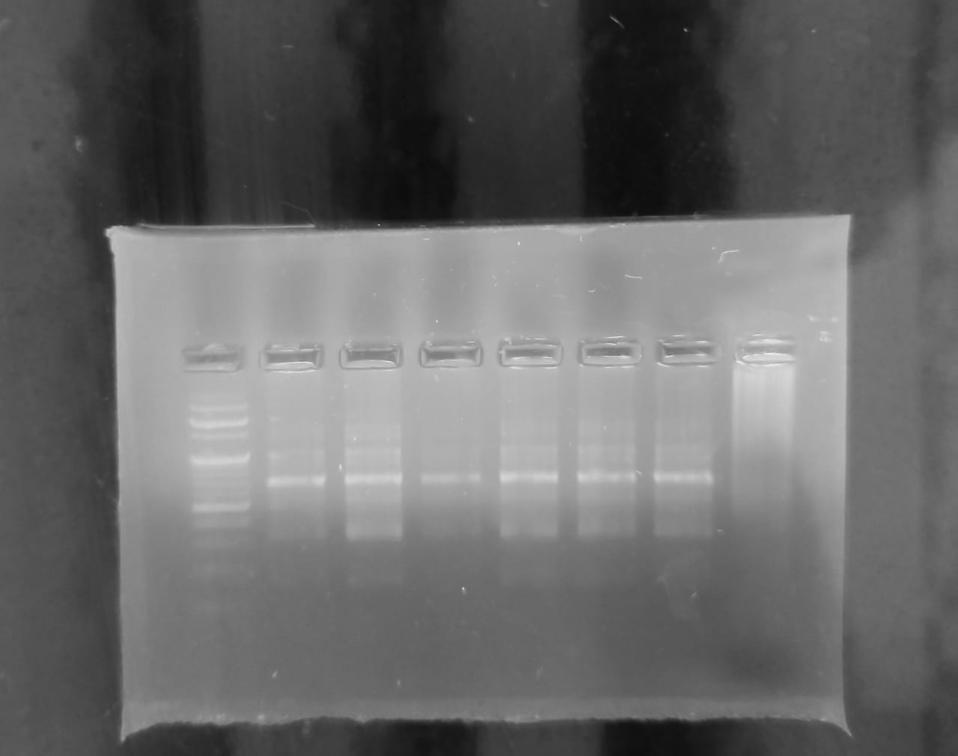
PCR amplification by using SSR markers
M 1 2 3 4 5 6 7
M= Ladder
1. IVT CODE 27
2. KDS-344
3. AMS2014
4. IVTCODE 20
5. NRC147
6. AMC-100-39
7.RSC1107
Fig1. SSR profile of Soybean genotypes generated by Satt 211

Slide 26
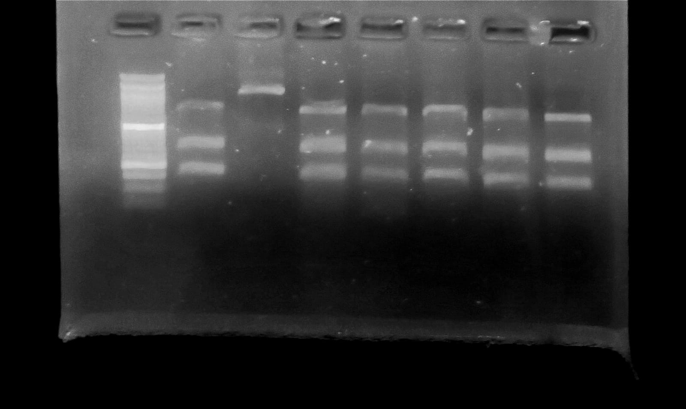
M 1 2 3 4 5 6 7
M= Ladder
1. IVT CODE 27
2. KDS-344
3. AMS2014
4. IVTCODE 20
5. NRC147
6. AMC-100-39
7.RSC1107
Fig2. SSR profile of Soybean genotypes generated by Satt 365

Slide 27
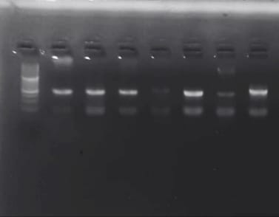
M 1 2 3 4 5 6 7
M= Ladder
1. IVT CODE 27
2. KDS-344
3. AMS2014
4. IVTCODE 20
5. NRC147
6. AMC-100-39
7.RSC1107
Fig 3. SSR profile of Soybean genotypes generated by Satt 338

Slide 28
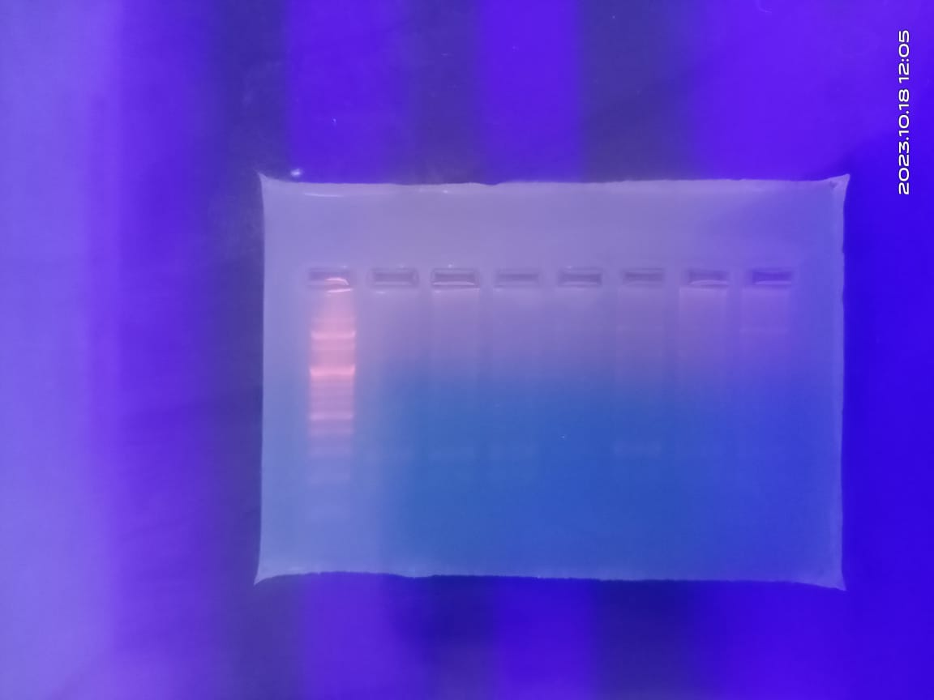
M= Ladder
IVT CODE 20
2. KDS-344
3. AMS2014
4. IVTCODE 20
5. NRC147
6. AMC-100-39
7.RSC1107
M 1 2 3 4 5 6 7
Fig 4. SSR profile of Soybean genotypes generated by Satt 342

Slide 29
1.Percent polymorphism
List of SSR primers and polymorphic amplicons generated.
Sr No. | Primer code | Total no. of amplicons | Total mo. of Polymorphic amplicons | Percent polymorphism
1. | Satt 211 | 2 | 2 | 100%
2. | Satt 365 | 3 | 1 | 25%
3. | Satt 338 | 2 | 1 | 50%
4. | Satt 266 | 1 | 0 | 0%
Total |  | 8 | 4 | 43.2%
Average number of amplicons per primer = 2
Average number of polymorphic amplicons per primer = 1
Total percent polymorphism by SSR marker = 43.2%

Slide 30
Binary similarity matrix for SSR analysis
A binary similarity matrix of combined data from 4 primers for the seven genotypes of Soybean were prepared by scoring bands for presence or absence.
Genetic Similarity estimate (Jaccard’s coefficient) based on SSR banding pattern used for cluster analysis to present genetic relationship in the form of dendrogram (fig.1) Jaccard’s coefficient value for seven soybean varieties are presented in the table.

Slide 31
Jaccard’s Binary Similarity Matrix for SSR Analysis
Varieties | IVTCODE27 | KDS344 | AMS2014 | IVTCODE20 | NRC147 | AMC100-39 | RSC1107
IVTCODE27 | 1.0000000
KDS344 | 0.3333333 | 1.0000000
AMS2014 | 0.7500000 | 0.4545455 | 1.0000000
IVTCODE20 | 0.5000000 | 0.4166667 | 0.3636364 | 1.0000000
NRC147 | 0.7000000 | 0.5833333 | 0.7000000 | 0.6363636 | 1.0000000
AMC100-39 | 0.7777778 | 0.5000000 | 0.7777778 | 0.5454545 | 0.9000000 | 1.0000000
RSC1107 | 0.7500000 | 0.3333333 | 0.7500000 | 0.3636364 | 0.7000000 | 0.7777778 | 1.000

Slide 32
Generated dendrogram of 7 Soybean based on Jaccard’s Similarity Coefficient :
Fig.1. Dendrogram showing results of SSR analysis of Soybean genotypes.

Slide 33
In present study, the similarity value ranged from 0.33 to 0.90 across 7 genotypes indicating high degree of genetic variation. This ultimately means high range of genetic diversity among the genotypes studied. The highest genetic similarity to an extent of 0.90 was recorded between AMC100-39 and NRC147. Least genetic similarity 0.33 was observed in between KDS344 and IVT CODE 27
A
The dendrogram analysis of 7 genotypes of soybean is divided into two groups group “A” and group “B”. the group “B” contain genotype KDS344
The group “A1” is further divided into two sub-groups “A1a” and “A1b”. The “A1a” contains RSC1107, AMS2014, , IVT CODE 27
The group “A1b” is contain NRC147,AMC100-39
A
A
A

Slide 34
Discussion
In the present study, genetic diversity among Glycine max species were analyzed by four primers among seven varieties.
Four primers were able to generate 4 amplicons out of these 8 amplicons were found polymorphic showing level of polymorphism 43.2% with an average amplicons per primer.
The Jaccard’s similarity coefficient among all varieties ranged from 0.33 to 0.90.
Highest similarity coefficient recorded in between AMC100-39 and NRC147 i.e. 0.90, whereas KDS344 and IVT CODE 27 showed lowest similarity of 0.33 in SSR marker analysis.
The result of cluster analysis indicated the separation of different varieties within same species.

Slide 35
(Discussion based on published research paper Chauhan et.al.,2015 used 21 SSR markers on 48 genotypes the values lied between 0.1-0.4 with average of 0.267, indicating an considerable diversity among the genotypes Maximum GS 0.72 was found between the genotypes MAUS81 and MAUS71; while minimum GS 0.05 was observed between the genotypes MAUS2 and PK262).

Slide 36
7. SUMMARY AND CONCLUSION
In present study, the similarity coefficient value ranged from 0.33 to 0.90 across 7 genotypes indicating high degree of genetic variation. This ultimately means high range of genetic diversity among the genotypes studied. The highest genetic similarity to an extent of 0.90 was recorded between AMC100-39 and NRC147 genotypes. Least genetic similarity 0.33 was observed in between KDS344 and IVT CODE 27

Slide 37
CONCLUSION
The genotypes with distinct DNA profiles provided useful information for selection of parents to develop new soybean hybrids.
• By this study, we can show how much diversity and similarity level is present in 7 genotypes of soybean.
• We can estimate the genetic distance among the genotypes of soybean and calculate the similarity coefficient among soybean genotypes

Slide 38
8. REFERENCES
Agarwal R K., Brar D S., Nandi S., Huang N., Khush G S. (2009). Phylogenetic relationship among Oryza species revealed by AFLP markers. Theor Appl Genet; 98:1320-1328.
Arslan E., Mutulu E., Dursun O., Bagci A. (2020). Comparative analysis of agronomic traits and ISSR method among some soybean (Glycine max (L.)Merr.) Genotypes. KSU J.Agric Nat; 23(3):687-696.
Botstein D., White R L., Skolnick M., Davis R W. (1980). Construction of a genetic linkage map in man using restriction fragment length polymorphisms. Am. J. Hum. Genet; 32:314-331.
Chakraborty B and Hazari S. (2016). Impact of Inorganic and Organic Manures on Yield of Soybean and Soil Properties. Soybean Research; 14(2):54-62.
Chauhan D K., Bhat J A., Thakur A K., Kumari S., Hussain Z., Satyawathi C T. (2015). Molecular characterization and genetic diversity assessment in soybean (Glycine max (L.) Merr.) varieties using SSR markers. Indian Journal of Biotechnology; 14:504-510.

Slide 39
Devi K N., Singh K., Singh M S., Singh S B., Singh K K. (2012). Influence of sulphur and boron fertilization on yield, quality, nutrient uptake and economics of soybean (Glycine max) under upland conditions. J Agric Sci; 4:1-10.
Doyle J J and Doyle J L. (1990). Isolation of plant DNA from fresh tissue. Focus; 12:13-15.
Garima D., Shreya S., Singh G and Kumar A., (2020). Soybean and Its Products: Nutritional and Health Benefits. J Nut Sci Heal Diet; 1(2):22-29.
Guan R., Chang R., Li Y., Wang L., Liu Z., Qiu L., (2010). Genetic diversity comparison between Chinese and Japanese soybeans (Glycine max (L.) Merr.) revealed by nuclear SSRS. Genet Resour Crop Evol; 57:229-242.
Ibanda A P., Karungi J., Malinga G M., Adjumati G. (2018). Influence of environment on soybean (Glycine max (L) Merr.) resistance to groundnut leaf miner (Apcoaerema modicella (Deventer)) in Uganda. J Plant Breed Crop Sci; 10(12):336

Slide 40
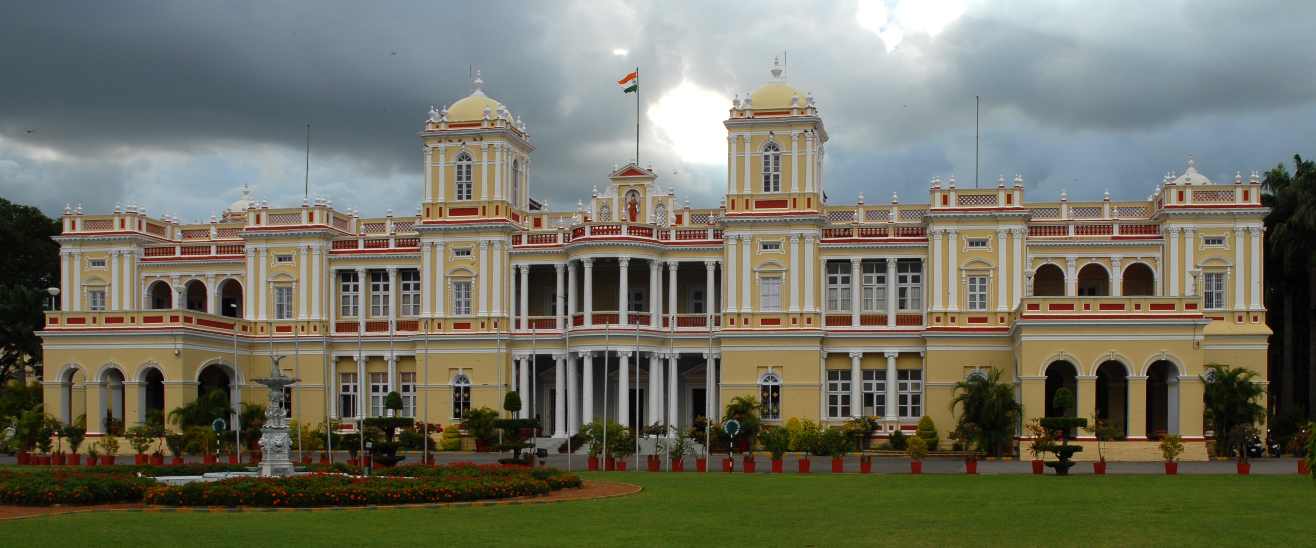

WELCOME
Prasad Nalwade

Slide 41


EDUCATIONAL TOUR REPORT
PRESENTED BY
Mr. Nalwade Prasad Ram
(BTL-44/2020)
COURSE No.
ET- 472
COURSE TITLE
EDUCATIONAL TOUR

Slide 42

TABLE OF CONTENTS
Preamble
Objectives
GKVK
Advanced Center for Plant Biotechnology
Botanical Garden
CFTRI
Mysore zoo
Scientific Information Gathered / Observations
Institution Related Photographs
Experienced Gained / Outcome

Slide 43
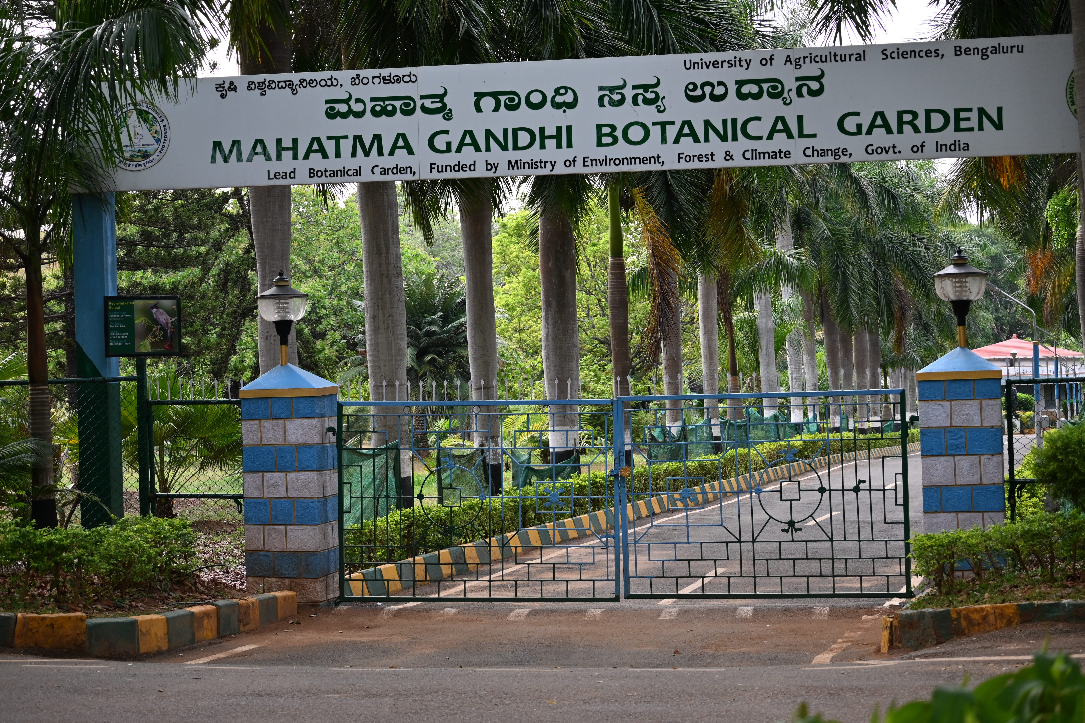
PREAMBLE
Educational tour to the institutions provides first-hand knowledge about the organizational structures and modes of operation in different institutions with the actual visit and thereby enhancing the cognition capacity of learners.
The purpose of the educational tour was to gather the scientific knowledge about the different fields related with the biotechnology and to visit various national and international institutions.

Slide 44

OBJECTIVES
To raise the complete knowledge about different techniques and also opportunities in the field of biotechnology and life sciences.
To enable participants to acquire a greater understanding of various institutions situated in Southern India.
To get the knowledge about on going research programs in the different institutions.
To know the vision, mission and mandate of the institutions.

Slide 45
PROFILE OF THE INSTITUTE
ADVANCED CENTER FOR PLANT BIOTECHNOLOGY
Established | 1996
Field of research | Plant Biotechnology
Head | Dr. Shyamalamma S
Total Area | 3380 sq. mtrs.
Location | Bengaluru, Karnataka, India
Campus | Urban
Official website | https://www.uasbangalore.edu.in/

Slide 46
BOTANICAL GARDEN
Established | 1975
Total Area | 100 acres
Director | Dr. R. Narayna
Location | Bangalore, Karnataka, India
Objective | Conservation of Plant species
Official website | https://www.uasbangalore.edu.in/

Slide 47
RESEARCH CONDUCTED THE GKVK INSTITUTE
Early bearing and high yielding Jack fruit varietiessuch as, Lalbagh Madura, Swarna and Byrachandra, have been released, and are bearing fruits in 4 years.
Elite Jackfruit genotypes and High throughput detection method developed for Cardamom Mosaic Virus (CdMV) Diagnosis.
Biosensor developed for detection of Papaya Ring Spot Virus (PRSV) infecting Papaya.
Compost tea (CT) foliar spray technology developed for enhanced Biomass, Yield and Late Blight management in Potato crop
Compost tea application for yield enhancement in groundnut, Marigold, Rice and other crops

Slide 48
varieties are multiplied for commercial purpose, with an annual revenue of Rs.8 to 9 lakhs
A large number of genomic resources developed in Ragi and Chickpea
Development of mapping populations and fine mapping of wilt resistance in Chickpea
Heat tolerant inbred lines developed in Maize and promising hybrids produced
Efficient strains of Microalgae for biofuel production identified
Multigene approach for the development of transgenic maize against Turcicum leaf blight is under progress.
Cloning and molecular characterization of antiviral proteins against BmNPV in mulberry plants (transient mode) is attempted.
Photosynthesis of nanoparticles, and application in Agriculture
DST-FIST funded, Department and Presently FIST- Level II is under operation

Slide 49
SCIENTIFIC INFORMATION GATHERED/OBSERVATIONS
At GKVK we visited the botanical garden having various species of plant kingdom and had look on giant water lily. At Advanced Center for Plant Biotechnology we received the great knowledge regarding PG research programs and various ongoing projects from the Asst. Prof. Dr. Nagesha N, Asst. Prof. Dr. Ningaraju T.M. and Dr. Bhavani P. Department of Plant Biotechnology,
Some of this are:-
DBT Project: - A value chain on Jackfruit and its value added products
Isolation and Molecular characterization of Natural and Mutated Yeast for High Ethanol Tolerance
Molecular Mechanism of Late Blight resistance in Potato
Compost tea application in a integrated and organic practice for disease resistance and Yield enhancement in crops
Phytosynthesis of silver nanoparticles and application in Agriculture and medicine
The Molecular nature of Santalum album root parasitism

Slide 50
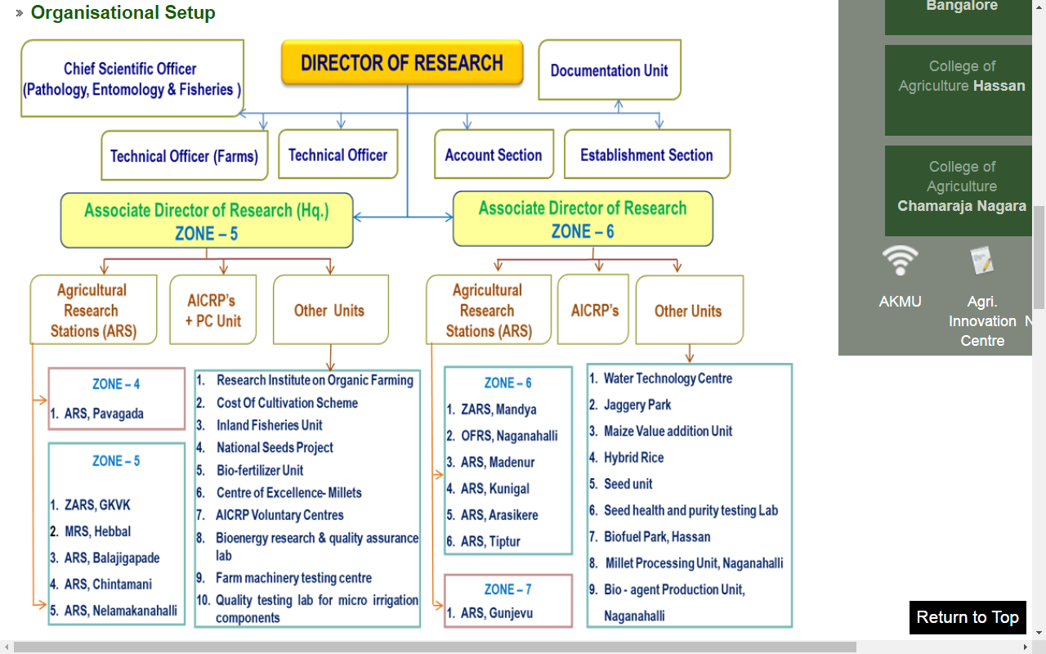
ORGANIZATION STRUCTURE OF GKVK

Slide 51
CSIR - CENTRAL FOOD TECHNOLOGICAL RESEARCH INSTITUTE
Established | 21 October 1950
Total Area | 200 acres
Director | Dr. Sridevi Annapurna Singh
Location | Mysore, Karnataka, India
Objective | Focused and targeted research initiatives in the area of Food Science & Technology
Official website | https://www.cftri.res.in/

Slide 52
RESEARCH CONDUCTED THE CFTRI INSTITUTE
A Novel Process for Preparation of Green Amla Powder:-
CSIR-CFTRI has developed a new green Amla powder process, separating green berries from ripe ones, washing them, drying, and grating them. The resulting powder has a natural green color and good aroma. The process involves grading, drying, homogenizing, and packaging the powder in opaque polyethylene pouches. The powder has a shelf life of over 3 months at 37±2°C in thermo-stable pouches, without any additives for flavor retention.
Probiotic Yeasts For Candida Infections:-
Candida infections pose a significant public health threat, particularly in healthy individuals with implanted medical devices. Impaired immune functions allow pathogens to infiltrate the digestive tract, leading to systemic infections. Yeast-based probiotics are a promising alternative due to their resistance to antibiotics.

Slide 53
Low Fat Probiotic Ice Cream:-
Researchers at CSIR-Central Food Technological Research Institute have created a low-fat synbiotic ice cream using β-manno-oligosaccharides (β-MOS), plant-derived fiber, and Lactobacillus plantarum and Lactobacillus fermentum as probiotics. The ice cream mix includes milk powder, sugar, fat, stabilizer, emulsifier, vanillin, and FOS.
Arabinoxylans:-
Arabinoxylans (AXs) are non-starch polysaccharides found in cereal brans, providing numerous functional and nutritional health benefits. They are water extractable and un-extractable, with ferulic acid being rich in antioxidants and aiding in colon cancer, diabetes, atherosclerosis, immunomodulation, and weight management. CSIR-CFTRI has standardized the preparation process.
Cancer Research:-
Metastasis is a complex cancer process involving cell adhesion, invasion, angiogenesis, and continuous proliferation. It is triggered by molecules like galectin-3, matrix metalloproteinases, and vascular endothelial growth factors. NFĸB and PGI are involved in this process, with dietary pectic polysacch playing a role in cancer cell survival.

Slide 54
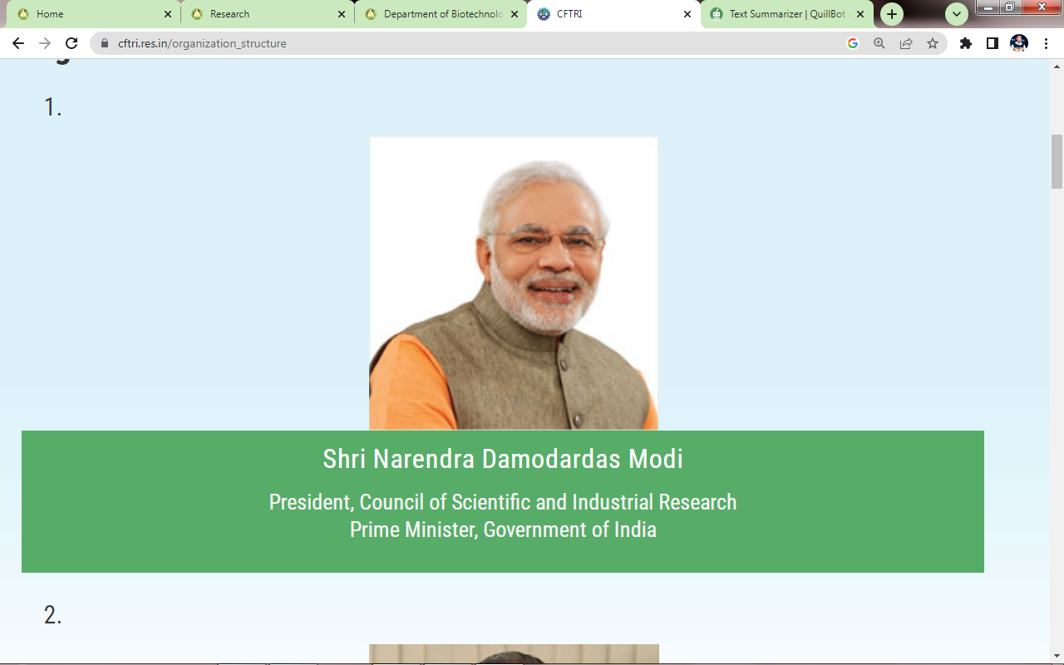
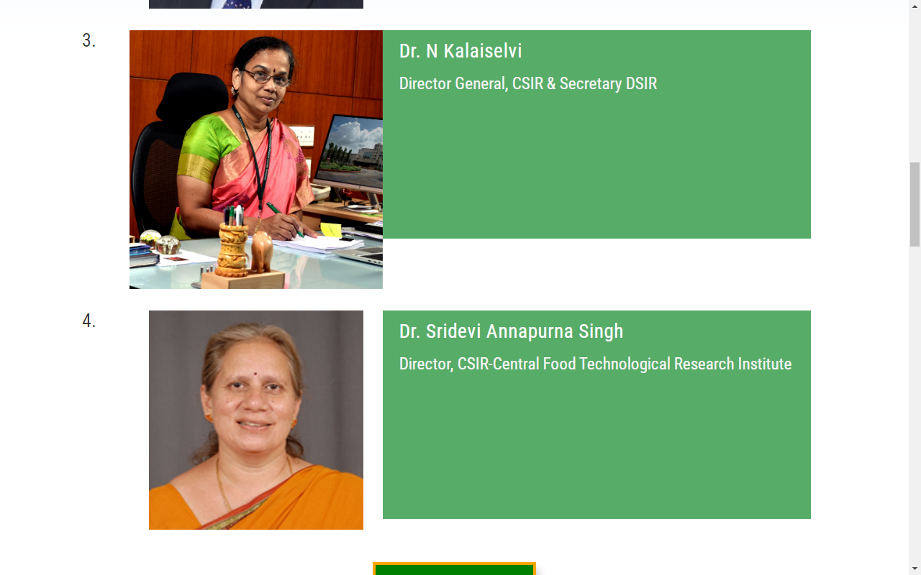
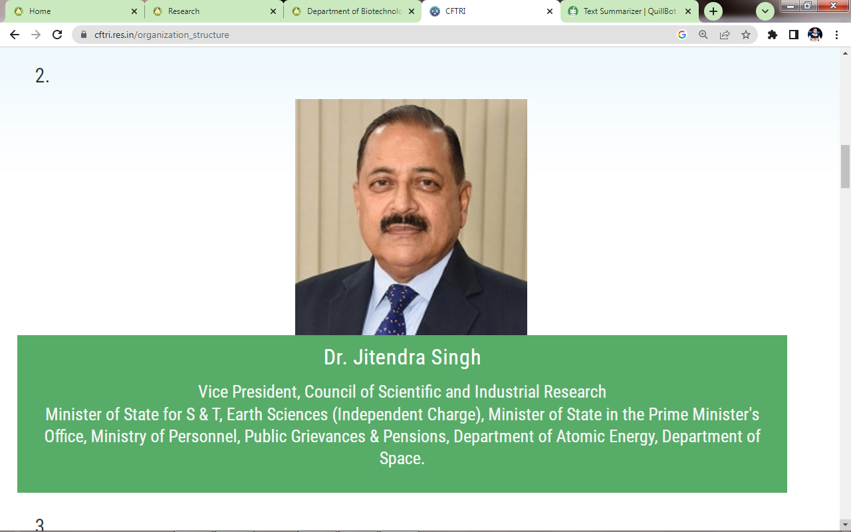
ORGANIZATION STRUCTURE CSIR-CFTRI

Slide 55
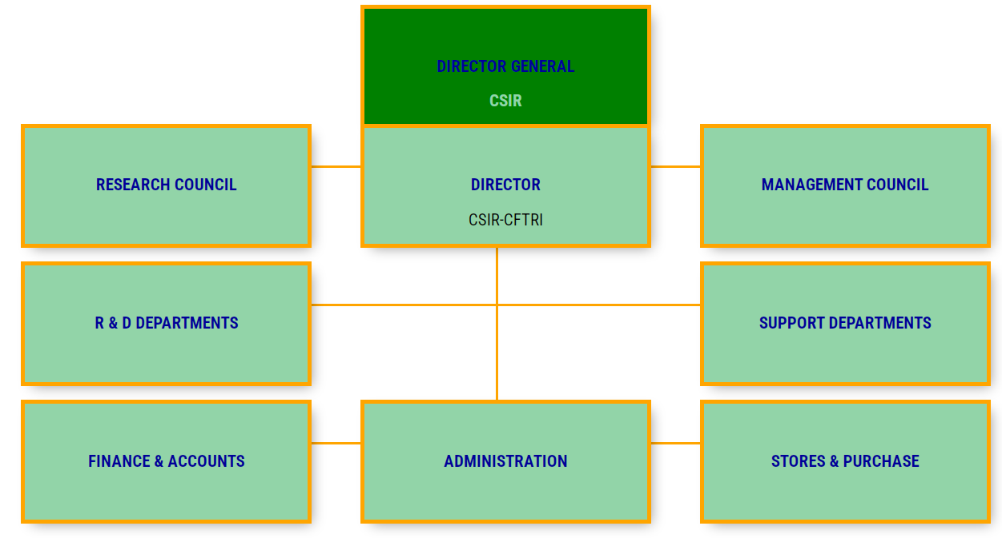

Slide 56
MYSORE ZOO
Established | 1892
Total Area | 17.12 acres
Director | Ajit Kulkarni
Location | Mysore, Karnataka, India
Objective | Support for wild animals and conservation
Official website | https://www.mysuruzoo.info/

Slide 57
MYSORE ZOO
Zoo was named after the founder Sri Chamarajendra Wodeyar Bahadur. Mr. G.H. Krumbeigal, a German Landscaper and a horticulturist was engaged who created the beautiful and attractive landscape of Mysuru Zoo.
It was established in the year 1892 and during 1909, It was named its founder, Sri Chamarajendra Wodeyar Bahadur. He engaged Mr. G.H. Krumbeigal, a German Landscaper and a horticulturist who had created the beautiful and attractive landscape.
At present it is housing more than 1450 specimen comprising 150 species representing more than 25 countries.
These fascinating Animals include:-
Big Cats: Tiger, Leopard, Lions, Jaguar, Cheetahs
Smaller Cats: Jungle Cat, Leopard Cat, Small Indian Civet, Common Palm Civet

Slide 58
Primates: Chimpanzee, Gorilla, Orangutans, Capuchin Monkey, Marmoset, Lion Tailed Macaque, Hoolock Gibbon, Baboon, Brown Lemur, Ring Tailed Lemur, Nilgiri Langur, Common Langur.
Deer and Antelopes: Spotted Deer, Hog Deer, Swamp Deer, Mouse Deer, Nilgai, Four Horned Antelope, Barking Deer, Black Buck, Fallow Deer, Goral.
Large Mammals: Asiatic Elephants, African Elephants, Indian Rhino, Southern White Rhino, Hippopotamus, Gaur.
Aquatic Birds: Eurasian spoonbill, Pelicans, Flamingo, Adjutant Stork, Painted Stork Sacred Ibis
Terrestrial Birds: Macaws, Conures, Pheasants, Sarus Crane, Great Indian Hornbill, Peafowl, Tragopan, Parrots and Parakeets.
Ducks: Muscovy Duck, Spotted Whistling Duck, Comb Duck, Carolina Wood Duck
Flightless Birds: Ostrich, Rhea, Cassowary and Emu
Reptiles: Anaconda, King Cobra, Indian Cobra, 7 types of Crocodiles, Iguana

Slide 59
Birds Species:-
Bar-headed goose | Jandaya conure | Darwin's rhea
Barn owl | Lady Amherst's pheasant | Eclectus parrot
Black-crowned night heron | Lesser adjutant | Eurasian spoonbill
Black-necked swan | Livingstone's turaco | Goffin's cockatoo
Blue-and-yellow macaw | Military macaw | Golden pheasant
Reptiles Species:-
Bengal monitor | King cobra
Gharial | Malabar pit viper
Green anaconda | Morelet's crocodile
Green iguana | Saltwater crocodile
Green vine snake | Siamese crocodile
African buffalo | Indian muntjac | Hamadryas baboon
African bush elephant | Indian leopard | Himalayan black bear
Asian elephant | Indian wolf | Himalayan goral
Asian palm civet | Jaguar | Hippopotamus
Mammals Species:-

Slide 60
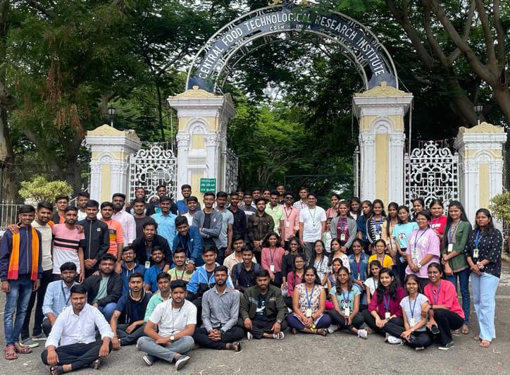
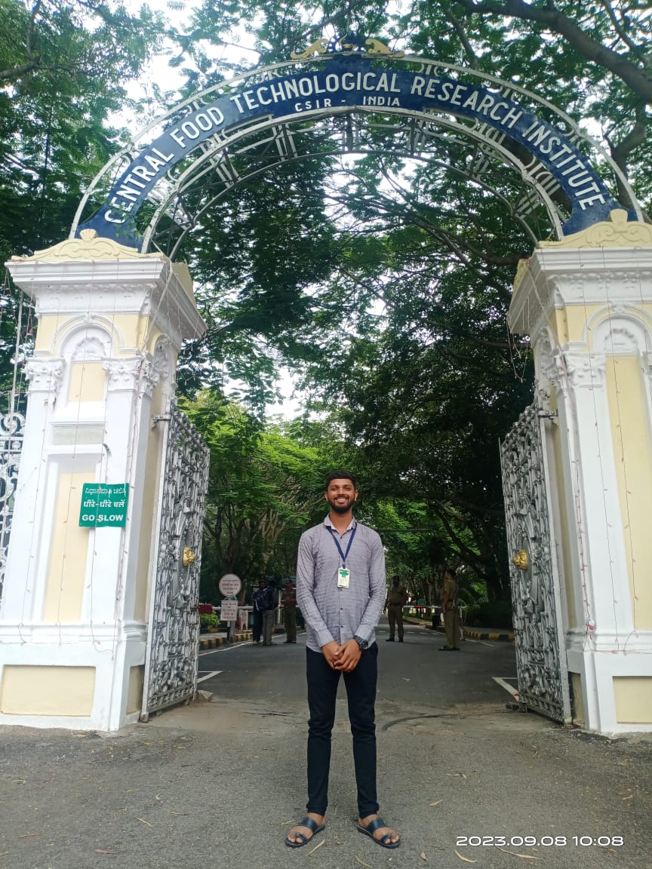
INSTITUTION RELATED PHOTOGRAPHS
Fig. 1 & 2 CSIR - Central Food Technological Research Institute

Slide 61
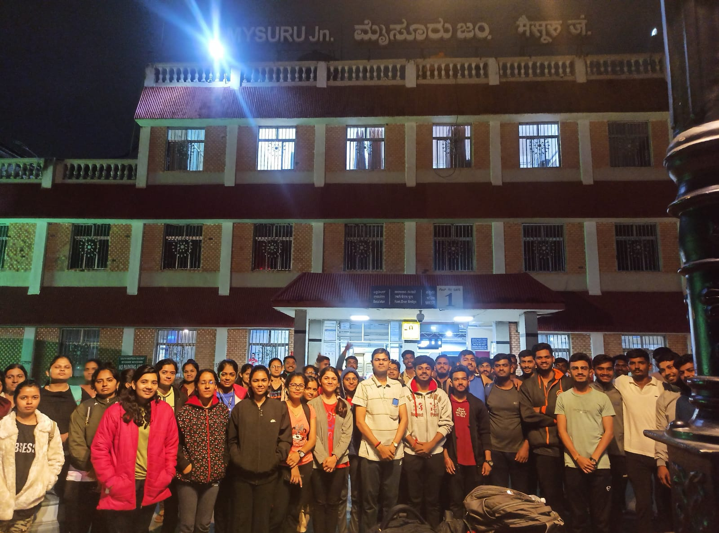
Fig. 10 Mysuru Junction

Slide 62
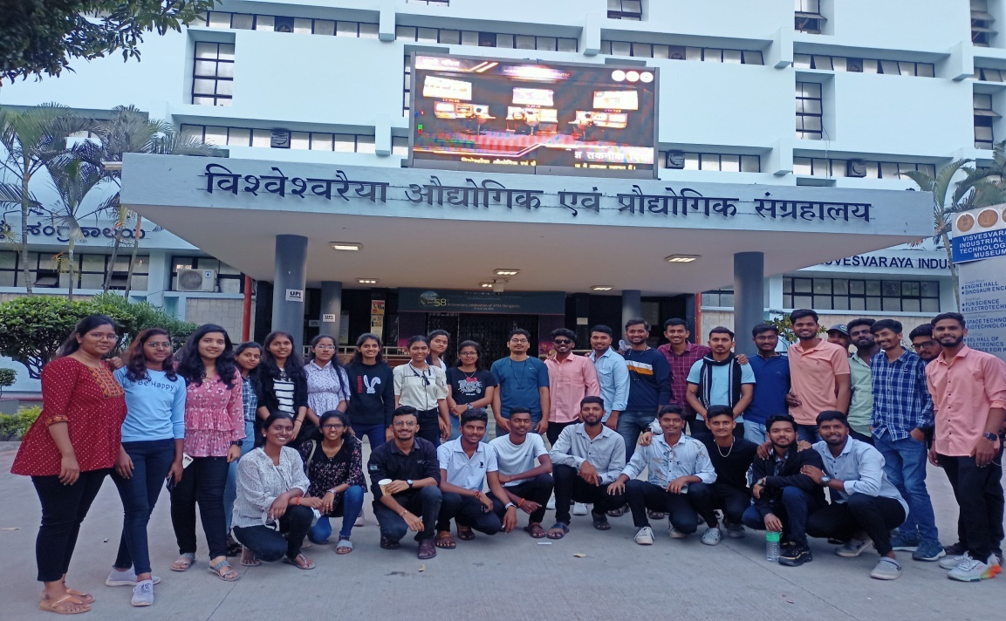
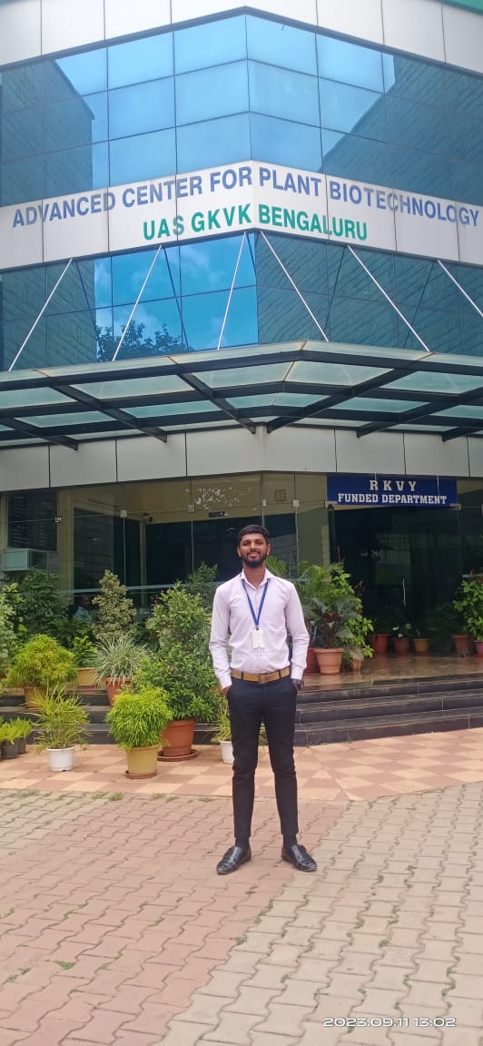
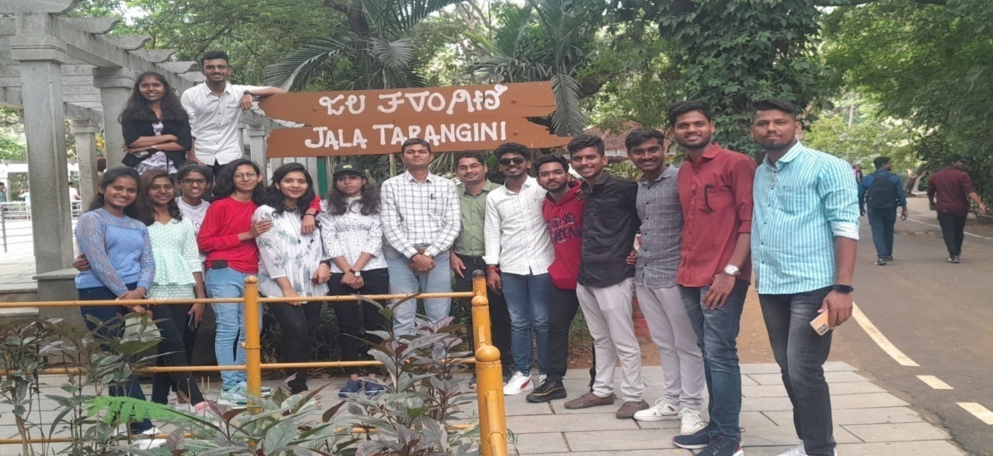
Fig. 3 Visvesvaraya Industrial & Technological Museum, Bangalore
Fig. 6 Advanced Centre for Plant Biotechnology
Fig. 9 Mysuru Zoo

Slide 63
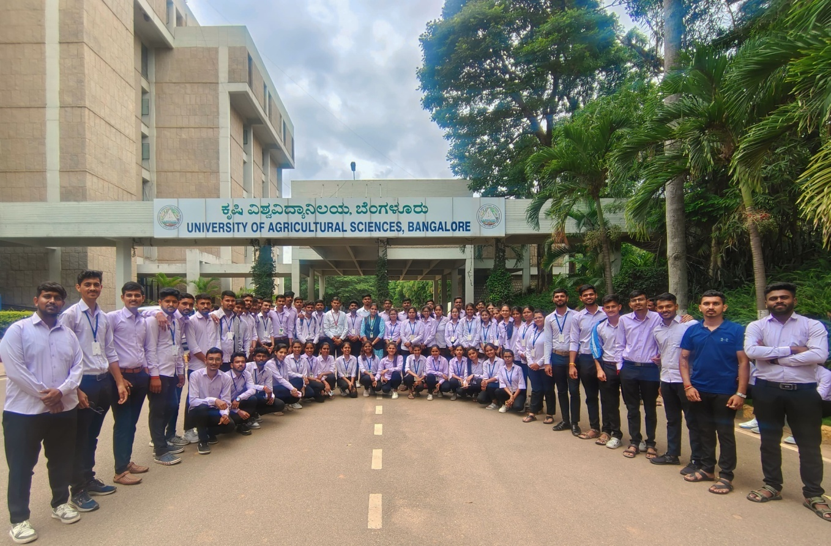
Fig. 4 University of Agricultural Sciences, Bangalore

Slide 64
EXPERIENCED GAINED / OUTCOME
It was an amazing experience for me to visit such fine and well established institute. They gives us a lot of information about various ongoing project related to our Agricultural Biotechnology course.
It also helps in application with biotechnology at its core the institute has invested in R&D and in extensive infrastructure to ensure the best possible products that match world standard.
They organize the webinar for farmers and give them information about modern farming and discussed their doubt. Also, the institutes continuously organize training programmed for students and farmers under the guidelines and different schemes.
Understood about currently working areas and laboratories of the institute.
Learnt about working mechanism of the institute via organization chart.
Understood about objectives and vision of the institute.

Slide 65
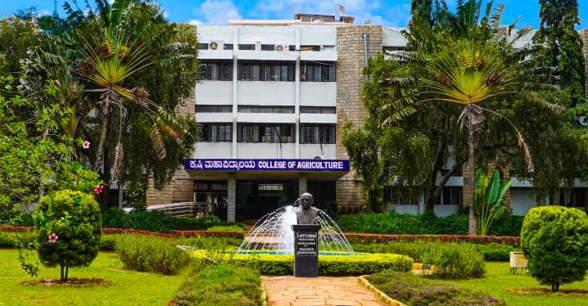
THANK YOU…
EDUCATIONAL TOUR

